Slide 1
Content Provider

Slide 2
Contains
Android
Content Provider
Why SQLite ?
What is Contract ?
How To Access ?
MIME Type

Slide 3

What is Android ?
Android is an open source & platform independent.
Linux based operating system.
Support various technologies.
It is used for developing mobile applications.
Highly optimized virtual machine.
Such as Smartphone, tablets, computers, televisions, etc.

Slide 4
Features Of Android
User Interface
Multi Touch
Multi Tasking
Multi Language Support
Web Browser
Connectivity
Wi-Fi Direct
Storage
Media Support
Messaging

Slide 5
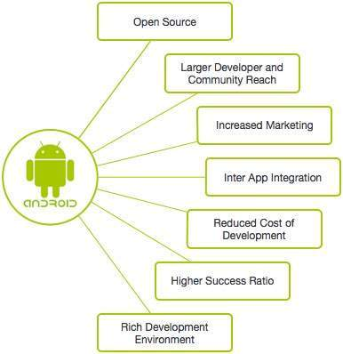
Why ?

Slide 6
Activities : An activity perform action on the screen. It represent a single screen with which user can interact. Services : It is used to perform background activities. Broadcast Receiver : It handle commutation between android OS & Application. Content Provider : It is used to share data between Application.
Components
Of
Android

Slide 7
What is Content Provider ?
Content = Data
Content Provider are used to share data between the applications.
It store data in one place.
It supplies data from one application to other on request.
It allow other applications to securely access & modify our app data based on our request.

Slide 8
What is Content Provider ?
It is a part of android application, which act as like as relational database to store app data.
We can perform multiple operations on that data like insert, delete, update, edit & so on.
It has different ways to store app data like in SQLite, files, or an cloud.
There are different types of access permissions available in Content Provider to share the data, we can restrict all these types of permissions to access the data of our data.

Slide 9
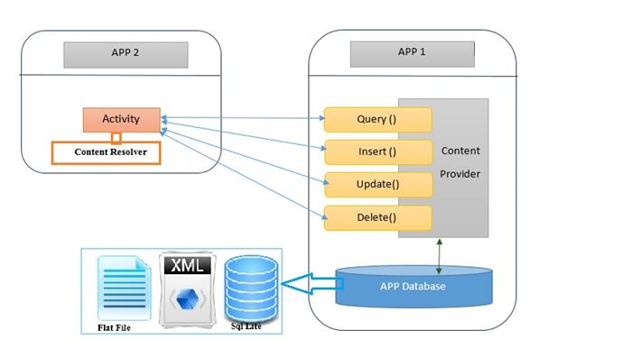
Example

Slide 10
What is it good for ?
Securely make data available to other apps.
Manage access permission to other apps.
Store data or develop backend independency from UI.
Standardized way of accessing data.
Required to work with CursorLorder.

Slide 11
Why SQLite Data Base?
Represent Data in Tables.
Easy to store & retrieve data.
Supports Same Operation as Content Provider.
Return Requested Data As Cursor.
Open Helper Class To Simplify Management.
Columns
Rows

Slide 12
What’s In A Contract?
Public class that document contain provider API.
Called Contract By Convention.
Contains:-
Content URI And URI Scheme To Query Data.
Table And Column Name For Returned Data.
MIME Types To Help Process Returned Data.
Shared Constants To Make Thing’s Easy.

Slide 13
Content URI
For Web Page We Use…
http://and File : //Uri of the page and file.
Content Uri is path to data and user content//
For Android We Use…
Content : // com.android.exemple.whatever

Slide 14
A General Form OF A Uri.
Syntax :- Scheme : // authority/path/id
Scheme:- Is Always Content : // For Content Uri.
Authority:- Represent The Domain. And For Content Providers Customarily ends in the Data.
Path:- path is the path of the data.
Id:- Uniquely Identifies The Data Set To Search.

Slide 15
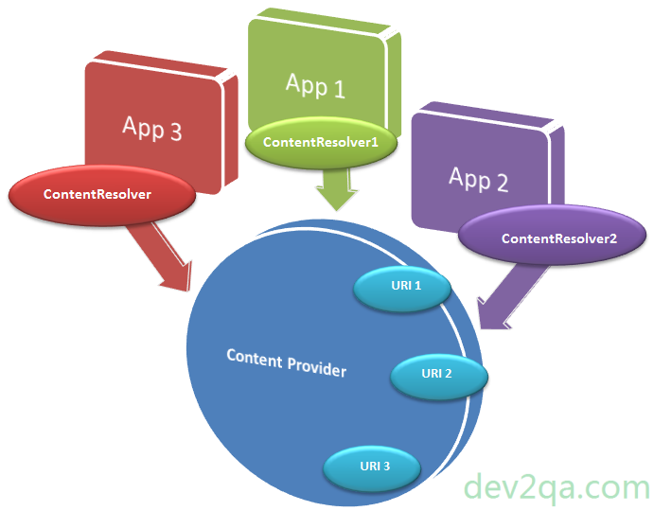

Slide 16
Multiple Internet Mail Extensions Type
Format Of Returned Data.
Text/html For Web page, Application / json For JSON Data.
App Calls getsType() to get MIME type From Provider.
Use Android’s Vended or - Specific Format For Your Content Providers MIME Type.

Slide 17
Use…
1. Query is returning zero or more values in Cursor.
2. Query is returning one value.
3. Application dependent content like audio/video/playlist.

Slide 18
Multiple Internet Mail Extensions
Content Provider use URI which is similar to URL.
Html /text Json/application pdf / application.
String ANY_CURSOR_ITEM_TYPE=“vnd .android.cursor.itme/*”;
String CURSOR_DIR_TYPE=“vnd .android.cursor.dir”;
String CURSOR_ITEM_BASE_TYPE=“vnd .android.cursor.itme”;

Slide 19
How to create custom MIME type?
Android Suggests :
1. Start with “vnd”
2. Reverse domain name.
3. Any custom string.
4. Append to standard Android MIME type.
For Example :
Content Resolver.CURSOR_DIR_BASE_TYPE+”/”+”vnd.com.reversedomain.todos”

Slide 20
How To Create Content Provider ?
Create ContentProvider class and inherit ContententProviderBaseClass.
2. Define URI address .
3. Need of database
Override onCreate() method.
4. Implements of queries.
5. Content provider registered of activity file
(Using <provider> tag).
ContentProvider
(Base Class)
extends
ContentProvider
Uri Address

Slide 21
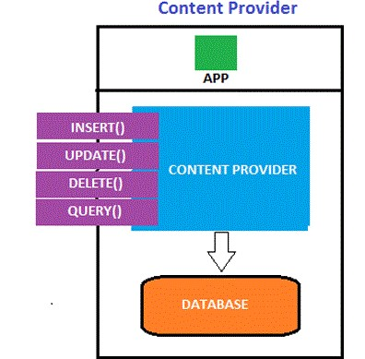
List of Content Provider Methods
onCreate() : This method start provider & are called provider.
query() : This method receives a request from a client . The result is returned as a Cursor object.
insert() : This method inserts a new records into the content Provider.
delete() : This method deletes an existing record from the Content provider.
update() : This method updates an existing record from the Content provider.
getType() : This method are returns the MIME type of the data at the given URI.

Slide 22
To Access Data
To create content provider firstly you have to extends Content Provider class.
Class that extends Content Provider class whose object is known as Provider object.
Whenever you have to access data from content provider you will have to use Content Resolver class object.
You access the data from the content provider as a client.
Content Resolver communicate with provider object.

Slide 23
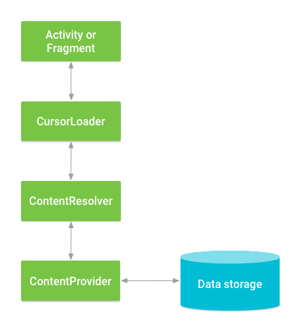
If you don’t want to share your data with another application, than there is no need to create content provider. But if you want to search data in your own application than you will have need to create content provider.
Content Resolver contains same methods as content Provider, that is why when you call any method from Content Resolver then it also calls same method in Content Provider.

Slide 24
Classes Involved In Content Provider
ContentProvider : Implements an API that exposes a set of data in a standard way. The main methods are Query, Insert, Update and Delete.
ContentResolver : A static proxy that communicates with a content provider to access its data, either from within the same application or from another application.

Slide 25
Accessing Data From Provider
ContentResolver client object is used to access data from Content Provider.
It communicates with provider object, which in turn accepts the request to access data and returns the desired results.
The data exchange interface provided by the provider and provider client object allows communication across different processes/applications.
The application that needs to access the database has to declare this and request permissions in its manifest file.

Slide 26
Thank You

